Slide 1

LoanSwift Pro
Your Fastlane to Financial Freedom

Slide 2
Table of contents
01
04
02
05
03
06
Project Overview
UI Screenshots
Tech Stack
Challenges Faced
Project Architecture
Future Enhancement

Slide 3
01
Project Overview

Slide 4
LoanSwift Pro Overview
LoanSwift Pro is a comprehensive Loan Management Application designed to simplify and streamline the loan application process for users. It leverages modern web technologies to provide a seamless experience for both applicants (LUMA) and administrators (LAMA).
Key Features
User-Friendly Interface: Intuitive and Responsive UI, ensuring a seamless experience for users.
Multi-Loan Support: Users can apply for various types of loans, such as personal loans, mortgages, or car loans, all within a single platform.
Loan Application Tracking: Applicants can track the status of their loan applications in real-time, reducing the need for follow-up communication.
Administrative Dashboard: Admins have access to a powerful dashboard for managing user accounts, reviewing applications, and generating reports
Secure Authentication: Robust user authentication and authorization mechanisms ensure data security and privacy.

Slide 5


Components
Frontend (React)
Backend (Spring Boot)
React, a powerful and flexible JavaScript library for building user interfaces. It offers an intuitive and user-friendly interface that allows applicants to apply for various types of loans easily.
Key features of the Frontend include:
User Registration and Login
Loan Application Form with Dynamic validation.
Real-time Loan Status updates.
Dashboard for Users to track their loan History.
Spring Boot, a Java-based framework known for its speed and simplicity in building robust web applications.
It serves as the backbone of LoanSwift Pro and is responsible for:
Managing User Accounts and Authentication.
Manage Loan Cards [C.R.U.D.]
Interacting with a Database to store and retrieve application data.
Handling communication with external services and APIs using Axios.

Slide 6
02
Tech Stack

Slide 7
















LoanSwift Pro Tech Stack
FRONTEND
BACKEND
DATABASE
TOOLS
SPRING
MySQL
REACT
SPRING BOOT
SPRING JPA

Slide 8
03
Project Architecture

Slide 9
Three Tier Architecture
The architecture of "LoanSwift Pro" is designed to be a scalable, maintainable, and secure web application. Follows three-tier architecture (1) presentation layer (frontend),(2) the application logic (backend), and the data storage layer (database).
Frontend
Backend
Database
User Interface (UI) : React - Dynamic & Responsive Web Applications
Components: Login, Registration & Loan Apply Forms
API Interaction: Axios [HTTP requests to backend API]
Responsive Design: Bootstrap & MUI
Application Logic: Core Business Logic & Database Communication
REST API Endpoints
Security: authentication and authorization
Database Interaction: Spring Data JPA interact with MySQL database for CRUD Operations
Data Storage: To store and manage structured data.
Data Access Layer: It translates high-level Java objects into database queries and results.

Slide 10
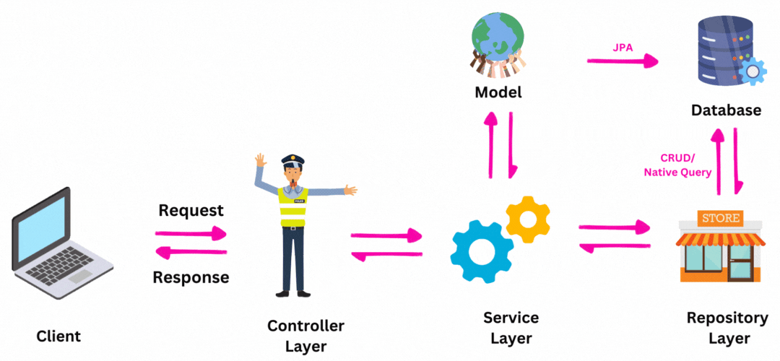
LoanSwift Pro Architecture (1)
BACKEND
FRONTEND
MySQL
React
DAO
Spring (MVC)
JPA
AXIOS

Slide 11
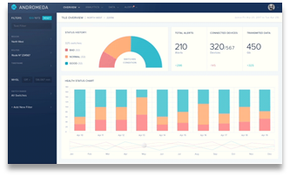





LoanSwift Pro Architecture (2)
Register & Login
Loan Customers Dashboard
Apply for Loan
Maintain Loan Items
Loan Seeker
Loan Admin
LoanSwift Pro
View Loans & Items Purchased
Loan Cards Management

Slide 12
04
UI Screenshots

Slide 13


Slide 14
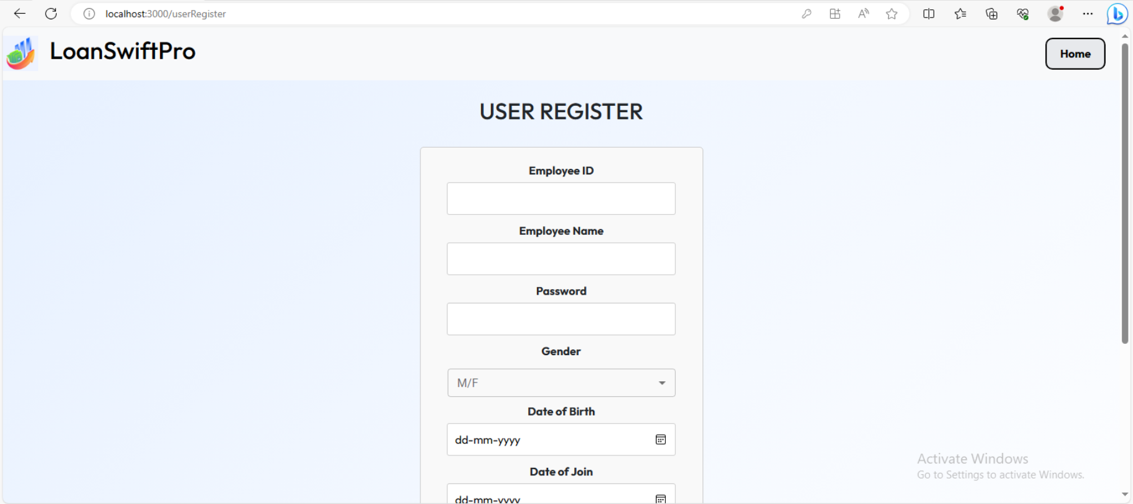
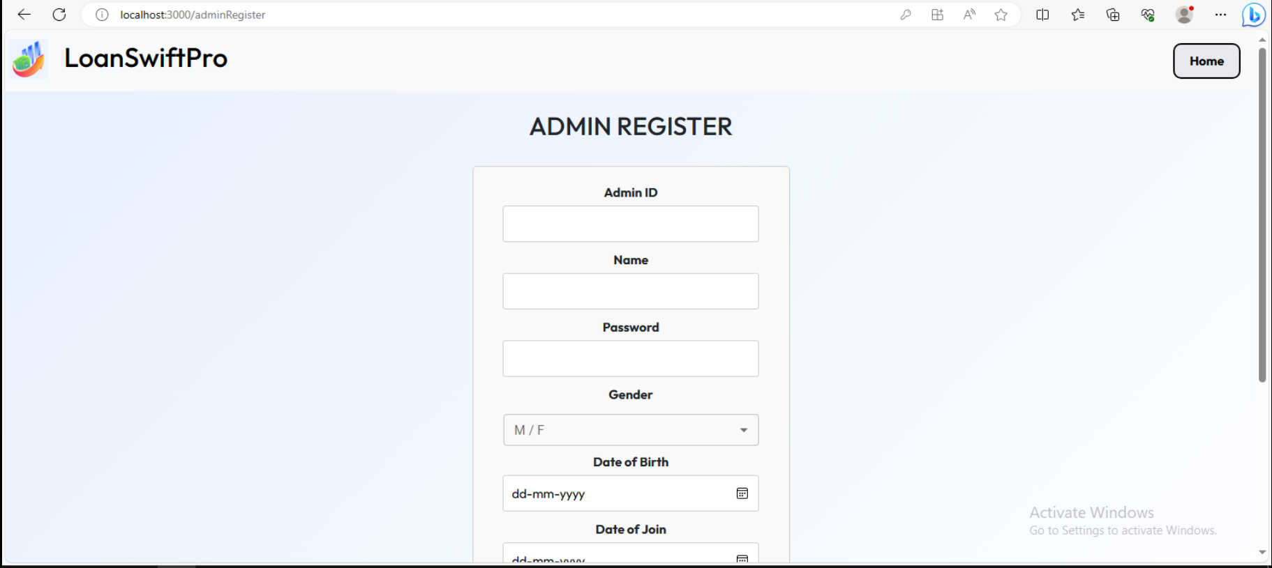
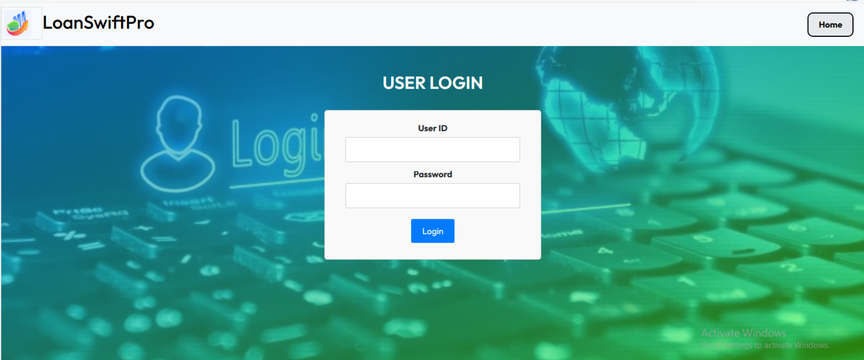
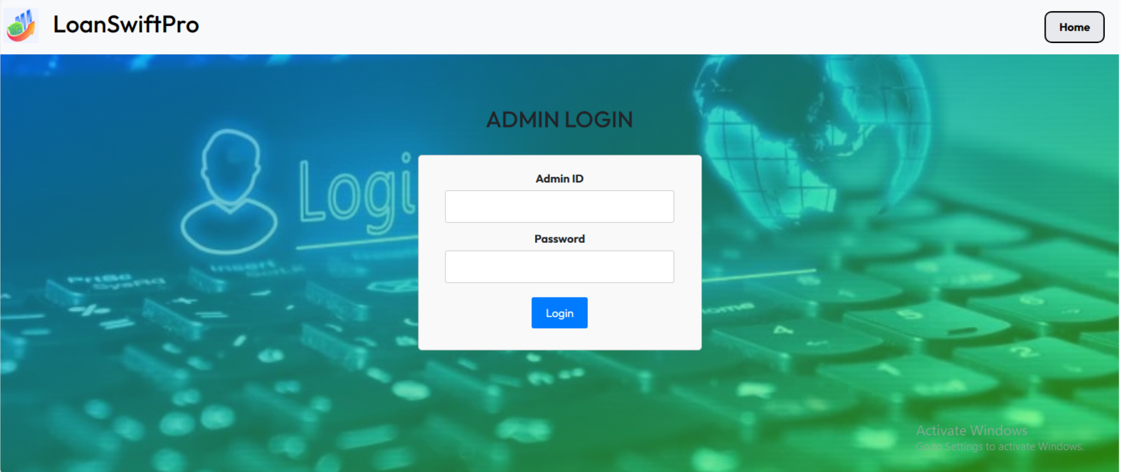

Slide 15
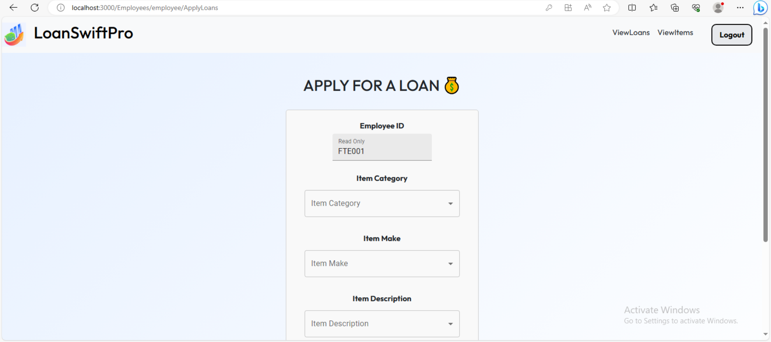
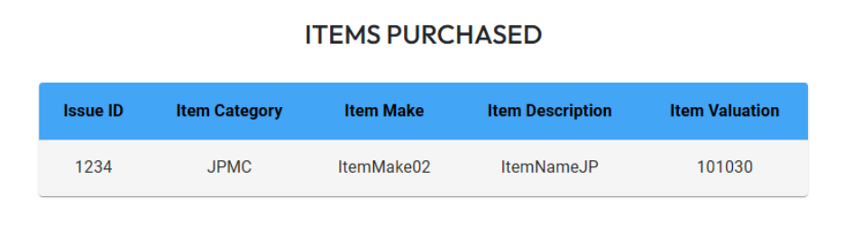
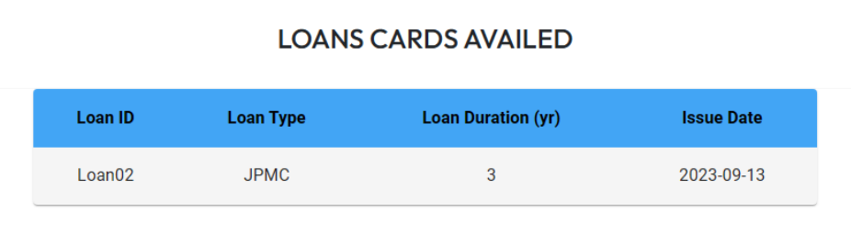

Slide 16
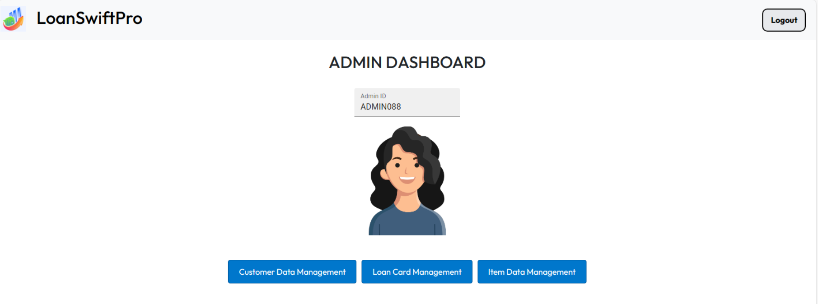
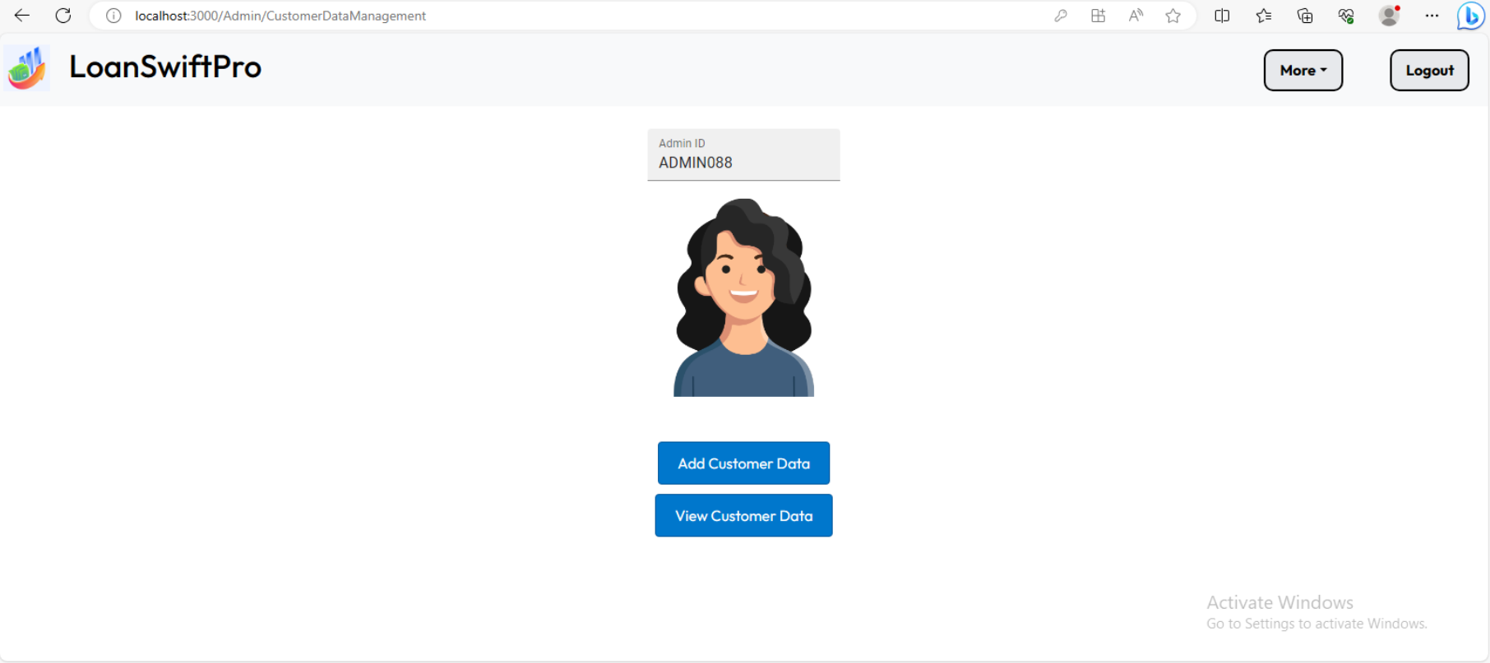

Slide 17
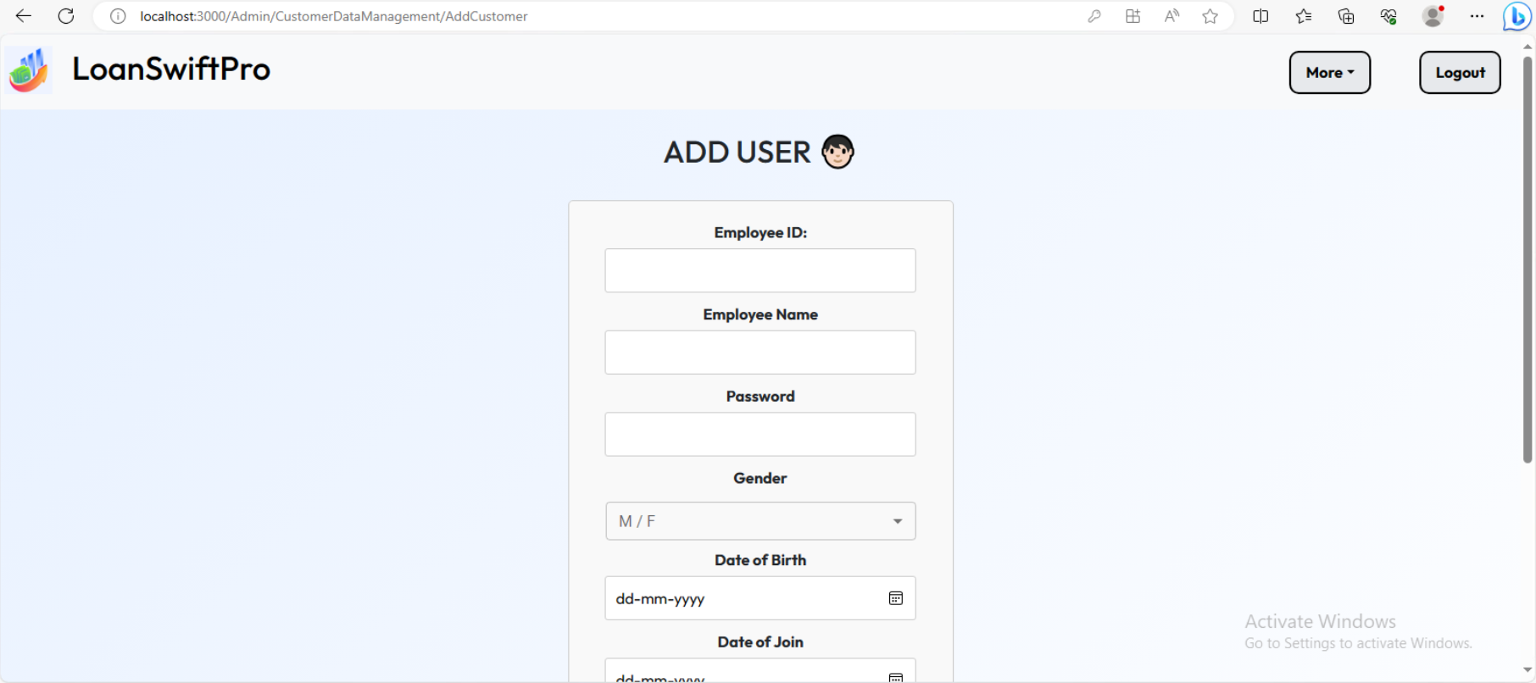
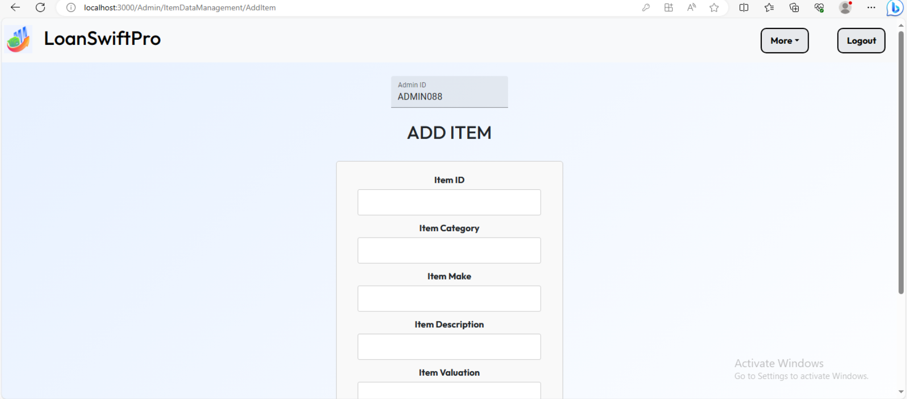
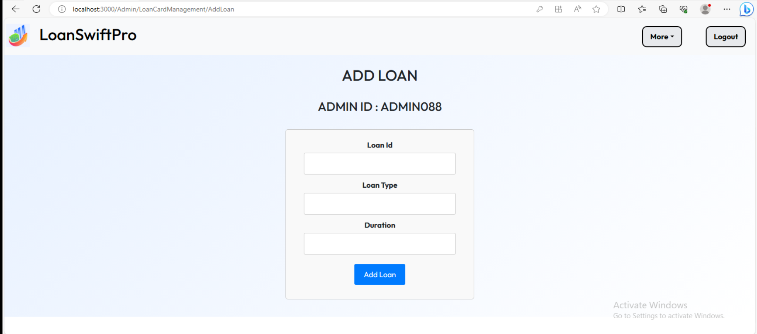

Slide 18
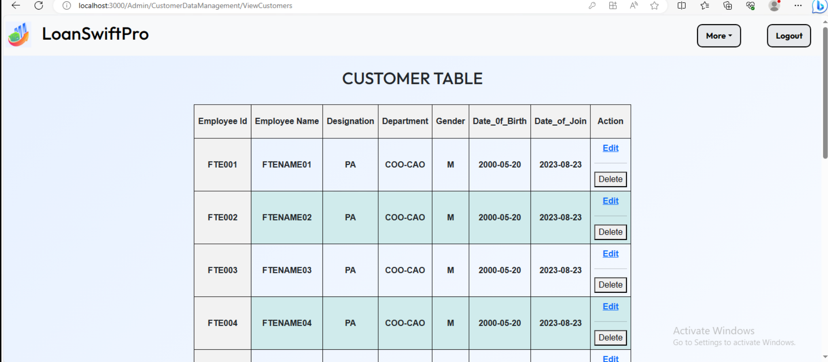
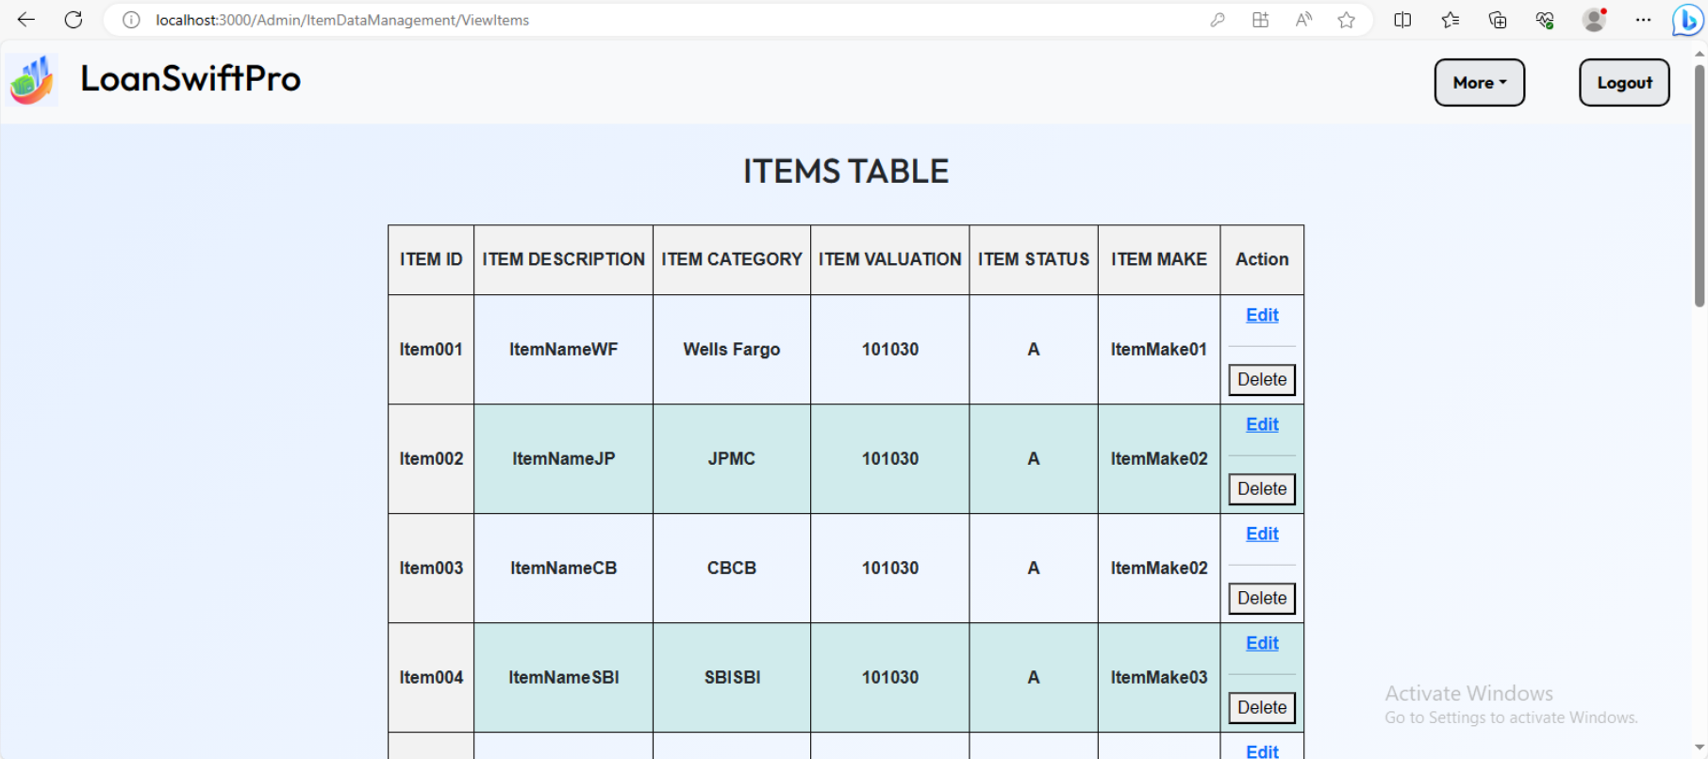
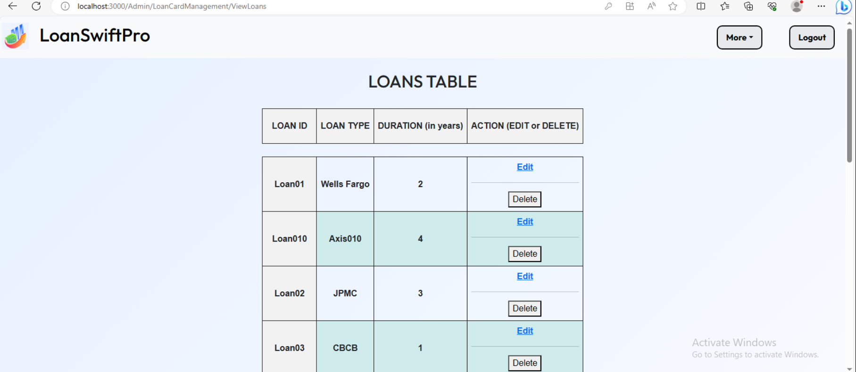

Slide 19
05
Challenges Faced

Slide 20
Challenges Faced
Integration: Making React and Spring work together smoothly can be tricky.
Security: Safeguarding user data and ensuring secure access requires careful handling.
State Management: Managing data across React components can get complex.
Performance: Ensuring the app runs fast, even with lots of users, can be a challenge.
Scalability: Designing the app to handle growth in users and data can be tough
User Experience: Creating an easy-to-use interface for applying for loans is important but can be hard.
Concurrency: Handling multiple users doing things at the same time is tricky.
Cross-Browser Compatibility: Making the app work well in different web browsers can be challenging.

Slide 21
06
Future Enhancement

Slide 22

Future Enhancements (1)
While LoanSwift Pro is already a powerful tool, we have plans for future enhancements to make it even more valuable:
Loan Repayment Calculators: Users can estimate their monthly loan payments, helping them make informed decisions. We are Currently just Applying for Loan and not Calculating the Financing Aspects like EMI.
Increased Security: Implementing Spring Security with Combination of JWT and OAuth.
Integration with External Services: The application leverages Axios to connect with external services for credit scoring, document verification, and more.
Deployment: Docker containers for application and database, Nginx as a reverse proxy, AWS (or your preferred cloud provider) for hosting.

Slide 23
Future Enhancements (2)
While LoanSwift Pro is already a powerful tool, we have plans for future enhancements to make it even more valuable:
Mobile App: Developing a mobile app version to provide users with on-the-go access.
Notifications: Implementing email or SMS notifications for application status updates.
Credit Score Integration: Integrating with credit bureaus for real-time credit scoring.
Document Upload: Allowing users to upload documents directly through the application & using OCR + AI for calculating Eligible Credit Amount.

Slide 24
Checklist ✔️
Demo
Our Project is Fully Functional and Working
Testing
Code is Tested Thoroughly (100% Code Coverage)
Coding Standards
Followed Naming Conventions, Comments, Intents & Code Refactoring
UI Validation
UI is Validated | Modern & Sleek Design
Exceptional Handling
Appropriate Exceptions are handled
Github
Version Control System (Git) is used Intensively

Slide 25
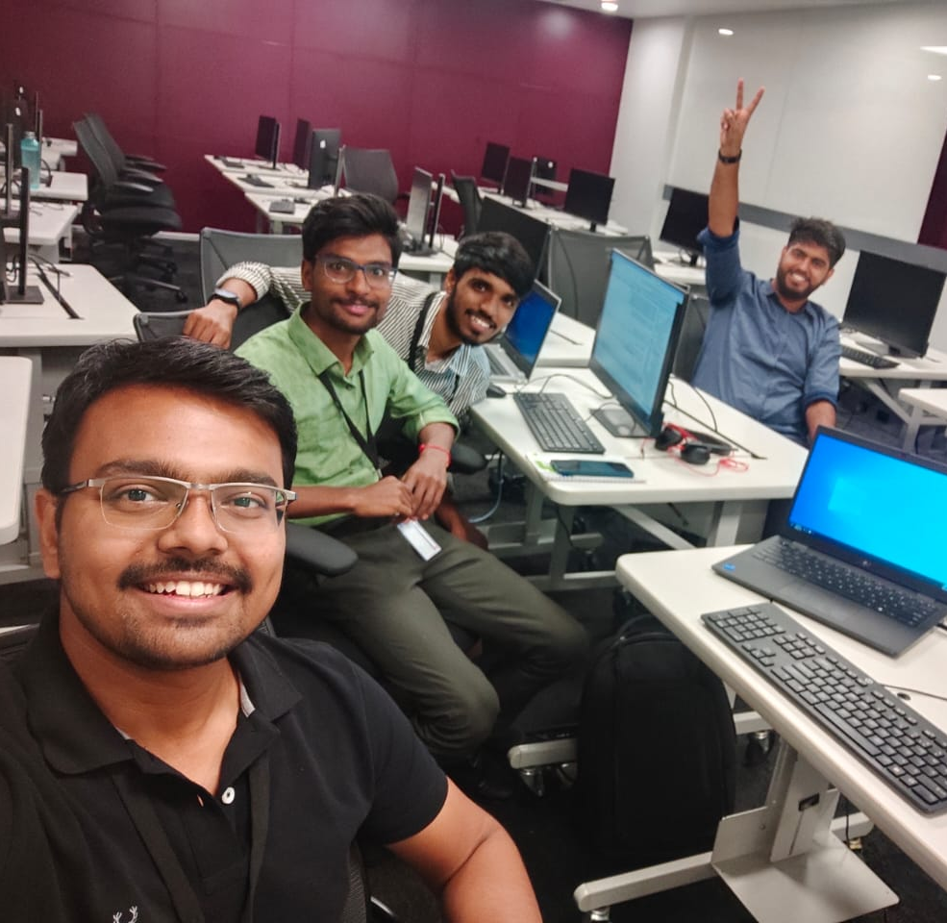

Conclusion
LoanSwift Pro is a feature-rich Loan Management Application built with the latest web technologies to simplify and enhance the loan application process.
It combines the power of React and Spring Boot to provide a seamless user experience and efficient backend operations.
I want to express my gratitude to the entire team for their hard work and dedication throughout this project. We look forward to your feedback and potential opportunities for further development and deployment.

Slide 26
Thank You
We are now Open for Any Questions related to LoanSwift Pro!

